Slide 1
Compression of point cloud
(EESM5547 Project 1)
Team member:
Suo Zihan (20305731)
Liu Qingyu (20297037)
Li Bin (20296588)
Huang Jingye (20294683)

Slide 2
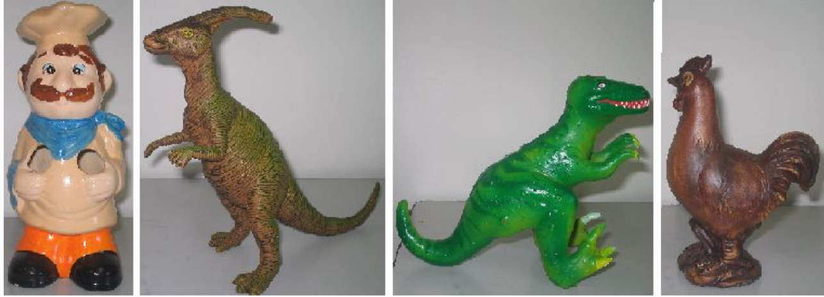
introduction
Point-cloud is an important representation for objects, scenes, medical data and so on. A point cloud is a set of data points in some coordinate system. Different from an image, for point-cloud, not all the coordinates will be defined with a value.
In our project, we have following steps:
1. Different methods will be used to compress four point cloud data sets (Chef, Kangaroo, Trex and Chicken);
2. After compression, we will make a comparison among all the methods and find out the one which has the best compression effect in terms of compression ratio, bit-rate, MSE and complexity.

Slide 3
methods
1. DCT
2. Random sampling
3. Predictive coding
4. Chord height error algorithm based on slicing

Slide 4
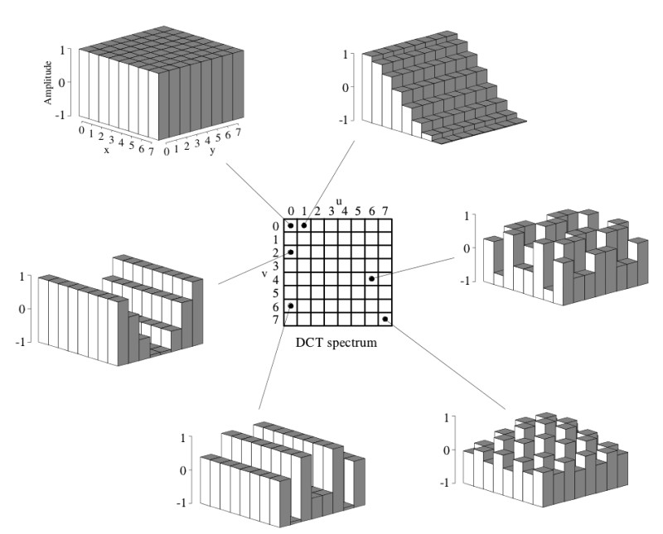
method 1: DCT
DCT expresses a finite sequence of data points with a sum of cosine functions at different frequencies.
After DCT, lower frequency domain stays at the upper left corner;
DC component stays at (0,0);
Higher frequency domain stays at the lower right corner.

Slide 5
method 1: DCT
Original data sets
Apply DCT and get a matrix expressing data in frequency domain
Discard high frequency part
IDCT and reconstruct the data
Make a comparison with the original data set
Procedure of DCT

Slide 6
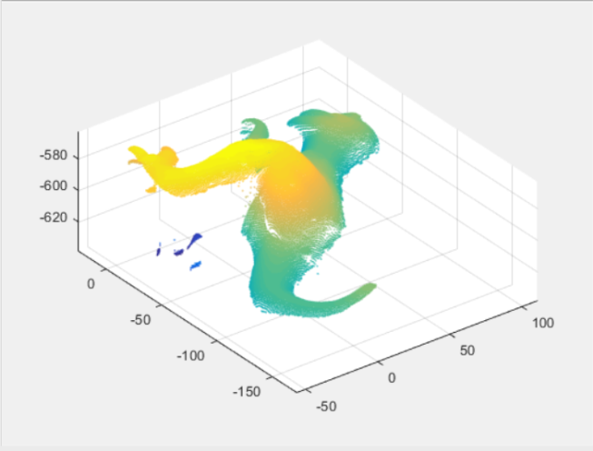
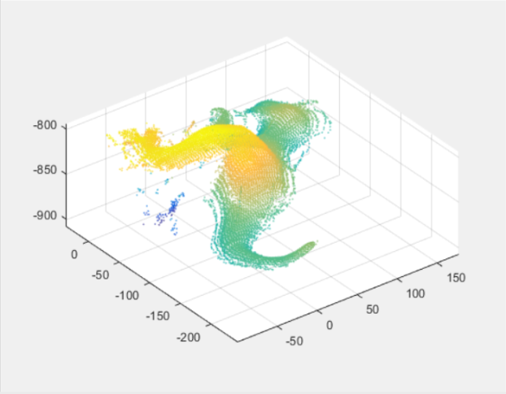
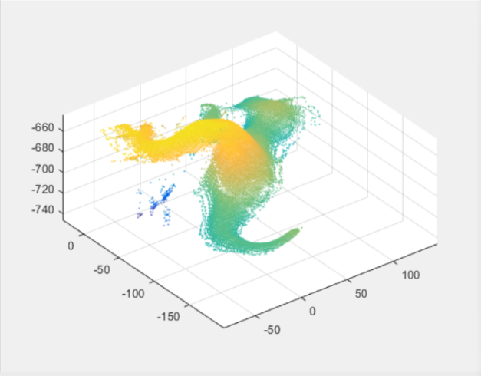
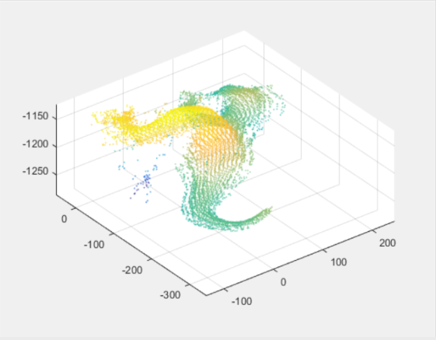
method 1: DCT
Figure 1 Original trex.dat output plot in 3D
Figure 2 Discard 19788 rows in the lower part
Figure 3 Discard 9694 rows in the lower part
Figure 4 Discard 29082 rows in the lower part

Slide 7
method 1: DCT
Comparison between three different levels of compression rate

Slide 8
method 1: DCT
Comparison between three different levels of running time

Slide 9
method 2: Random Sampling
Random sampling is a method which discard the data points randomly selected. This method is designed and created by ourselves.
Advantage: It is easy to process;
Disadvantage: It may cost high data loss when the discard data points are in a large amount.

Slide 10
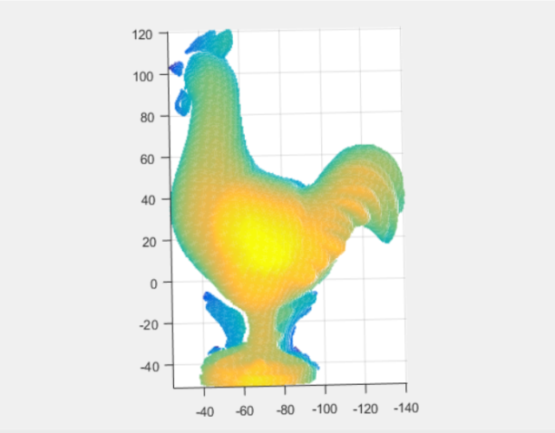

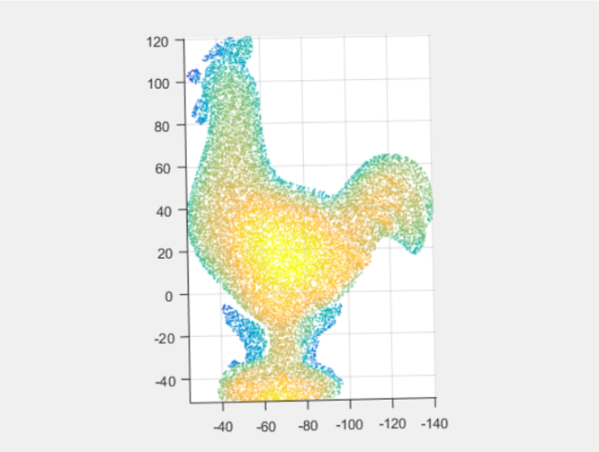
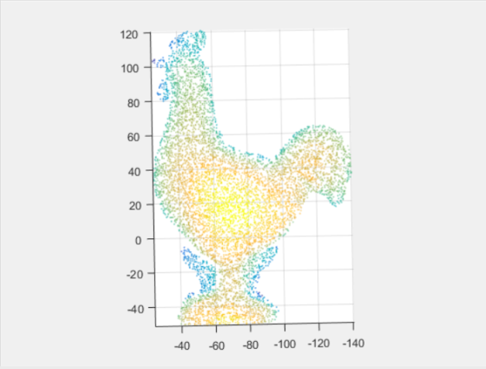
method 2: Random Sampling
Figure 5 Original chicken.dat output plot in 3D
Figure 6 Randomly discard 10000 points
Figure 7 Randomly discard 20000 points
Figure 8 Randomly discard 25000 points
MSE can be seen in the figure,
if the discarded point number is greater, MSE is higher.

Slide 11
method 2: Random Sampling
Comparison between three different levels of compression rate

Slide 12
method 2: Random Sampling
Comparison between three different levels of running time

Slide 13
method 3: Predictive Coding
Predictive coding is an attempt to predict the value of a data point based on the values of the surrounding data points.
In this project, we use the last data point value to predict next data point value. Then we do quantization based on the error matrix for the purpose of compression.

Slide 14
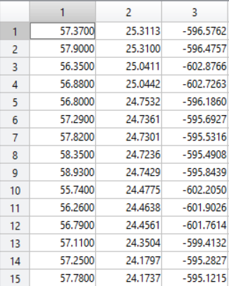
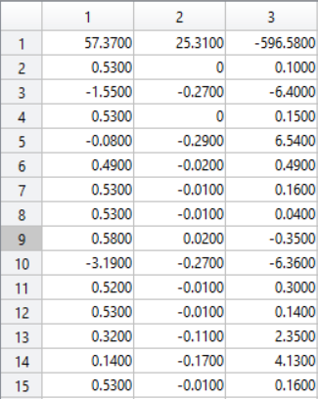
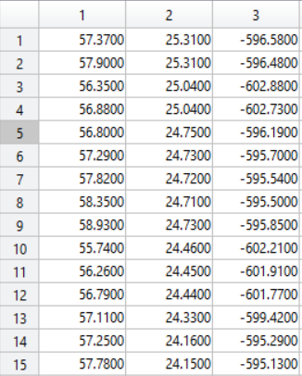
method 3: Predictive Coding
trex.dat data set
error matrix after quantization
Retrieved data set
Retrieved data set

Slide 15
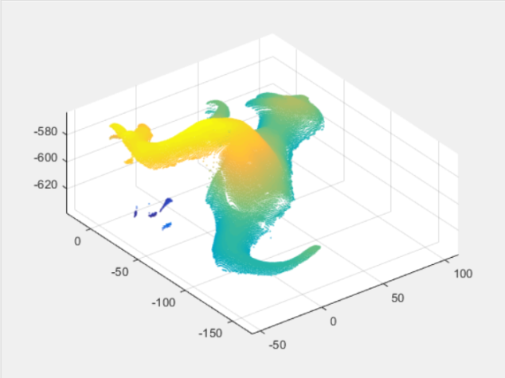
method 3: Predictive Coding
Original trex.dat output plot in 3D
Predictive coding & Quantization output plot

Slide 16
method 4: Slicing
Compression ratio of predictive coding = 0.6898
MSE of predictive coding = 2.9513
Complexity of predictive coding = 0.7706s

Slide 17
method 4: Slicing
This method is a high-efficiency data reduction method. It is based on slicing technology.
On the basis of the sequence, we can calculate the vertical distance between one point and its two adjacent points. If the vertical distance is greater than threshold which we set, then we retain this point. Otherwise we will discard it.

Slide 18
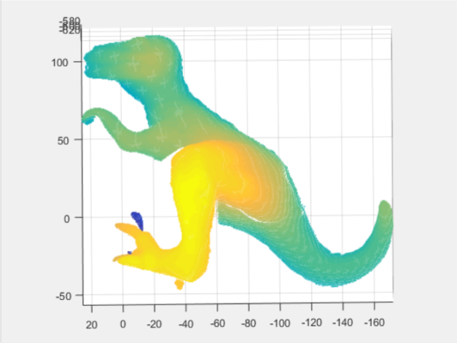
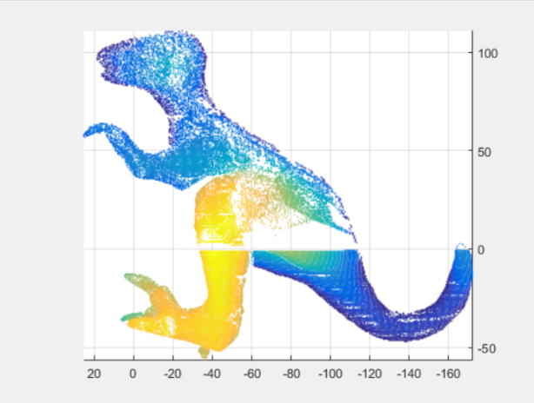
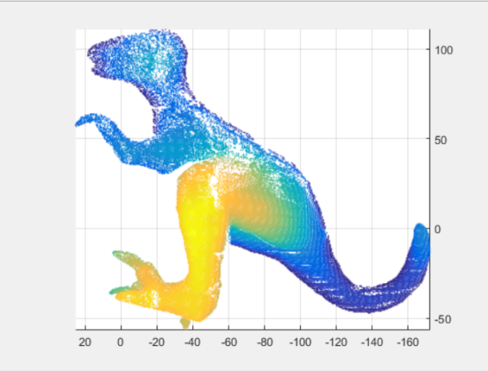
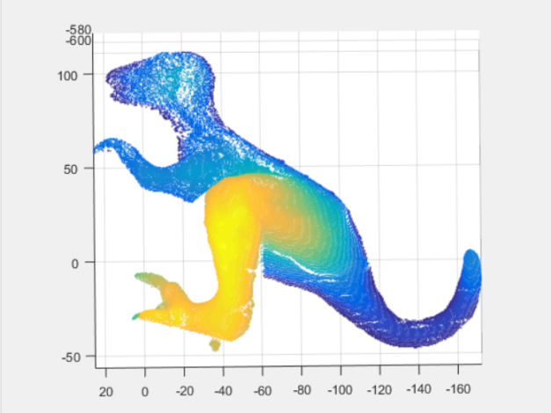
method 4: Slicing
The original output plot
Threshold=1 output plot
Threshold=0.75 output plot
Threshold=0.5 output plot
MSE can be seen in the figure, if the threshold is larger, the MSE is higher.
(c) Threshold=0.75 output plot (d) Threshold=0.5 output plot

Slide 19
method 4: Slicing
Comparison between three different levels of compression rate

Slide 20
method 4: Slicing
Comparison between three different levels of running time

Slide 21
Comparison & Conclusion
According to the results we got,
DCT method has the highest MSE and high complexity;
Random sampling has the shortest processing time but it may cause loss of important data;
Predictive coding has the lowest MSE but also has the highest complexity;
Chord height error algorithm based on slicing method has low distortion and the complexity is slightly high.
 | DCT | Random Sampling | Predictive Coding | Chord height error algorithm based on slicing
Compression Rate | Around 0.6898
MSE | High distortion | Low distortion | 2.9513 | Low distortion
Complexity | 0.6122s | 0.0070s | 0.7706s | 0.2100s

Slide 22
Comparison & Conclusion
With the same compressing rate, we hope to compare the complexity (running time). As shown below, random sampling is the best referring to this index.

Slide 23
Workload
5.1. Discuss which coding methods to be used—Liu Qingyu, Huang jingye, Li Bin.(2 hours)
5.2DCT coding and debugging---Liu Qingyu, Huang jingye, Li Bin, Suo Zihan (6 hours)
5.3 Random sampling coding and debugging---Liu Qingyu, Huang jingye (4 hours)
5.4 Predictive coding and debugging---Liu Qingyu, Huang jingye (5 hours)
5.5 DWT coding and attempting---Suo Zihan, Liu Qingyu (2 hours)
5.6 OcTree coding and attempting---Li Bin, Liu Qingyu (2 hours)
5.7 Chord height error algorithm based on slicing ---Liu Qingyu, Suo Zihan (2 hours)
5.8 Data collecting and reorganization—Suo Zihan, Huang Jingye (2 hours)
5.9 Presentation preparation and editing--- Suo Zihan (3 hours)
5.10Final report preparation and editing---Huang jingye, Li Bin (3hours)

Slide 24
Workload
5.1 Li Bin—Discuss which coding methods to be used and edit DCT, DFT, OcTree coding, and get graphic results of DCT, prepare final report.
5.2 Liu Qingyu--- Discuss which coding methods to be used and edit DCT, Random sampling, Predictive coding, slicing coding and get graphic results.
5.3 Huang Jingye--- Edit DCT, Predictive coding, Random sampling coding and get graphic results, prepare and reorganize final report.
5.4 Suo Zihan---Discuss which coding methods to be used and edit DCT, DWT,slicing coding, collect and reorganize data, prepare final presentation.

Slide 25
Thanks!!

